Slide 1
Sea War
So the game starts with placing ships to the grid and we have description in the beginning to guide the user to play the game properly. In addition, you cannot place the ship next to another one, there is need to be one square between them. Then after both players established their ships on their places the real game begins. After first player starts the game and then starts the second player, despite hitting or missing.
In the end the points will be given to the players and wins the one who destroys the most number of ships.

Slide 2
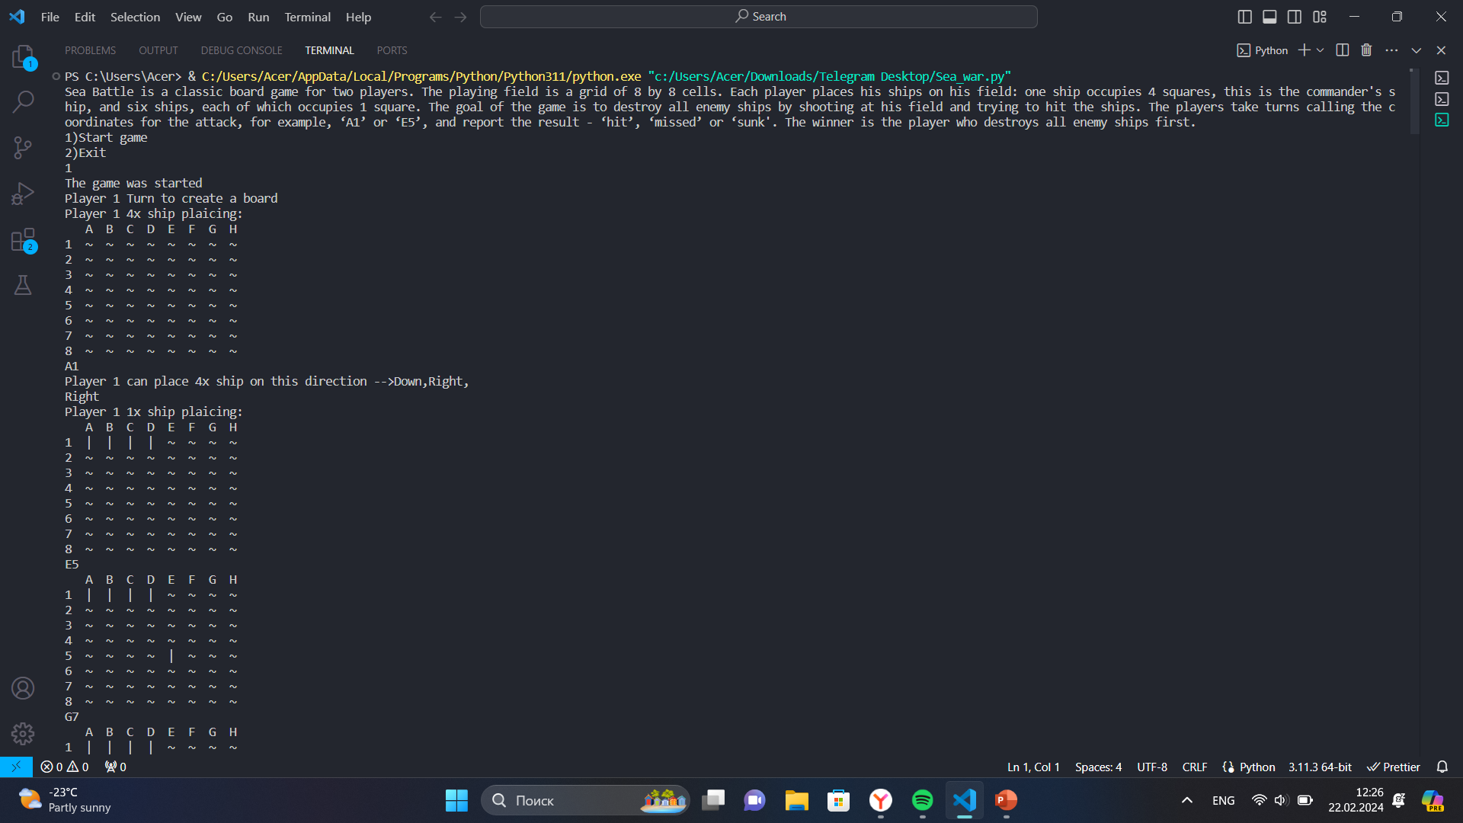
The starting point of the game and placing the ships. By misplacing the ship, it will show the sentence “Chose another point”

Slide 3
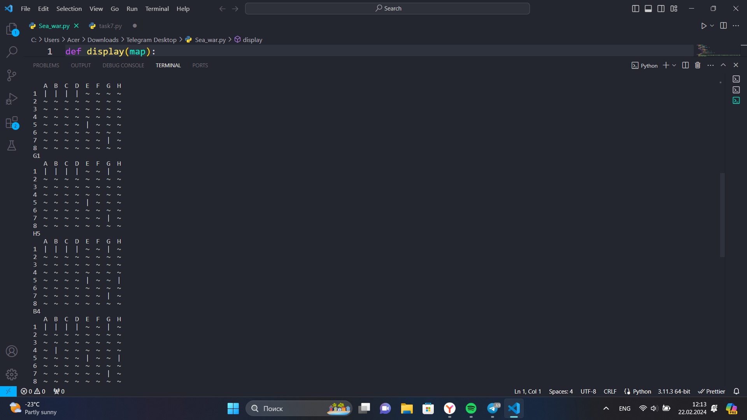
Same for second player. We have one ship which occupies 4 squares, this is the commander's ship, and six ships, each of which occupies 1 square

Slide 4
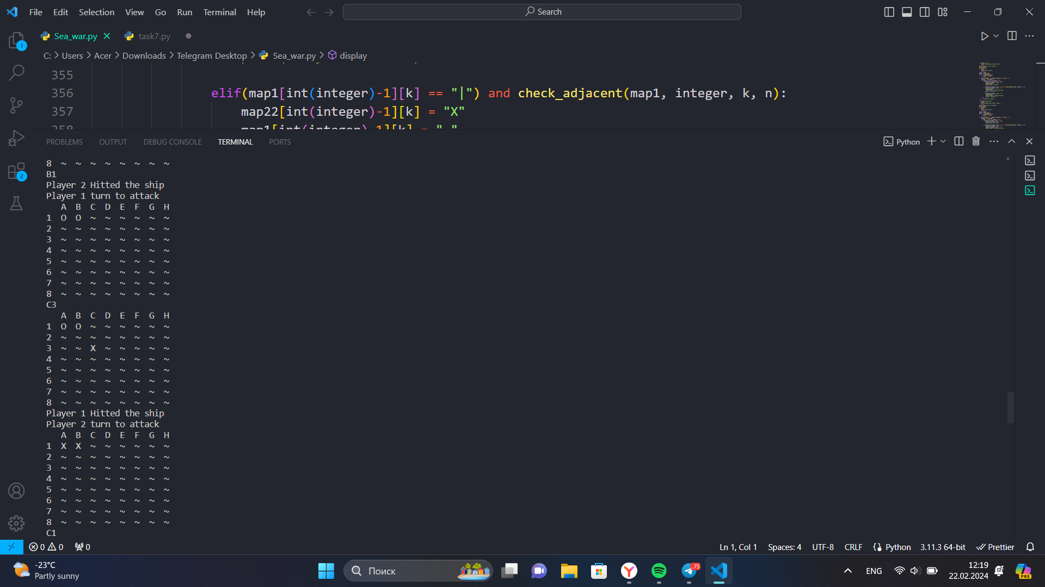
If we hit the ship it will be marked as “0” and if we hit it will be “X”.
Game ends with appropriate message displaying the winner.

